Slide 1
Movies Recommender System
Machine Learning Project

Slide 2
Team members
Nguyen Huy Bao
Nguyen Nhat Khiem
Trinh Binh Nguyen
ITDSIU21076
ITDSIU21091
ITDSIU21103

Slide 3
Table of contents
01
02
03
04
Data Selection & Preprocessing
Vector Database Implementation
Utilities for System
Demonstration

Slide 4
01
Data Selection & Preprocess

Slide 5

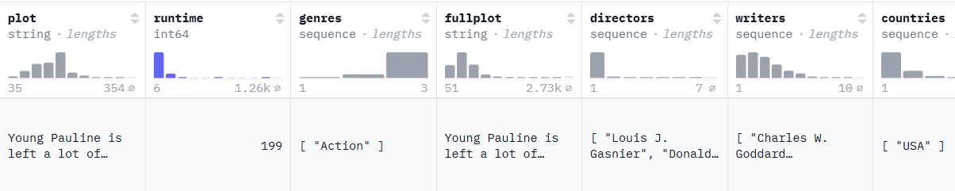
Data Selection
The dataset was selected from Hugging Face for its comprehensive coverage of movie metadata:
Plot descriptions for semantic embedding.
Genre and runtime for metadata-based filtering.
Contributors and filming locations for added context.

Slide 6
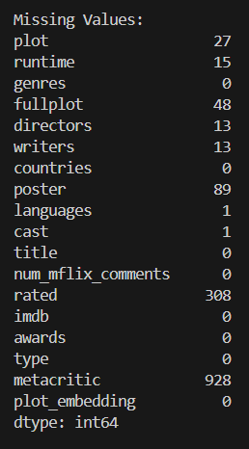
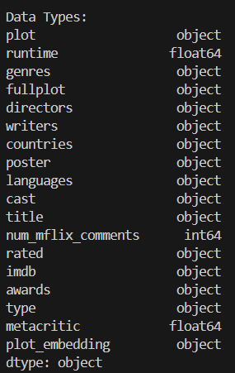
Data Preprocess
Column Cleaning:
Removed unnecessary columns like Metacritic .
• Converted string representations of lists (e.g., directors, cast) into comma-separated strings.
Handling Missing Data:
Imputed missing values where necessary.
Dropped rows with insufficient data in critical fields such as plot, poster, rated, Metacritic.

Slide 7
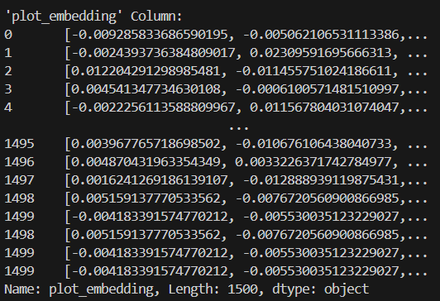
Data Preprocess
Transformed plot into vector embeddings using the nomic-embedded-text model through Ollama API.
Add a new column plot_embedding to store the generated vectors (as described below)

Slide 8
02
Vector database selection & creation

Slide 9


Why MongoDB?
MongoDB is built on a scale out architecture that has become popular with developers of all kinds for developing scalable applications with evolving data schemas.

Slide 10
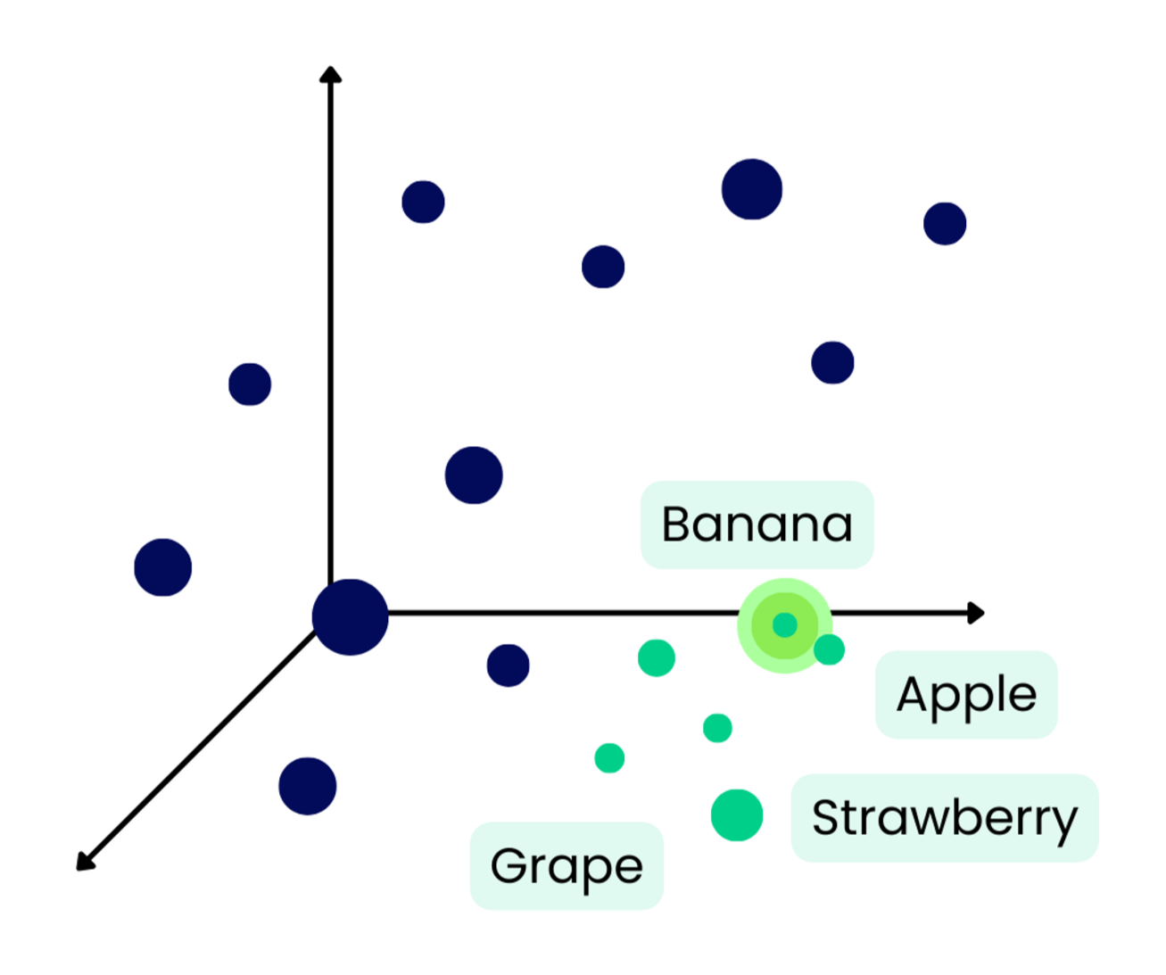
Why MongoDB ?
Atlas Vector Search currently supports the ingestion, indexing, and querying of scalar quantized vectors from embedding providers.
You can convert your data into vector embeddings, retrieve them with search capabilities, and build intelligent applications quickly and easily in MongoDB Atlas.

Slide 11
03
Utilities

Slide 12
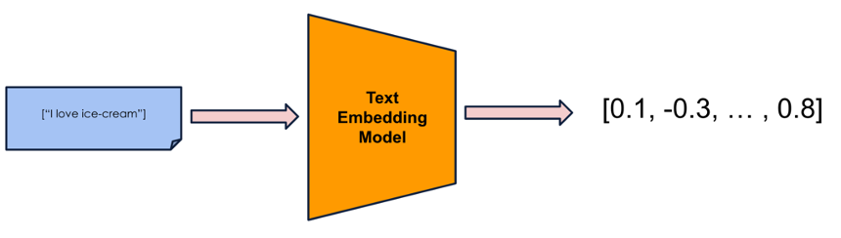

Create embedding column

Slide 13
Store data in MongoDB
After we embed the plot then we store everything in MongoDB

Slide 14

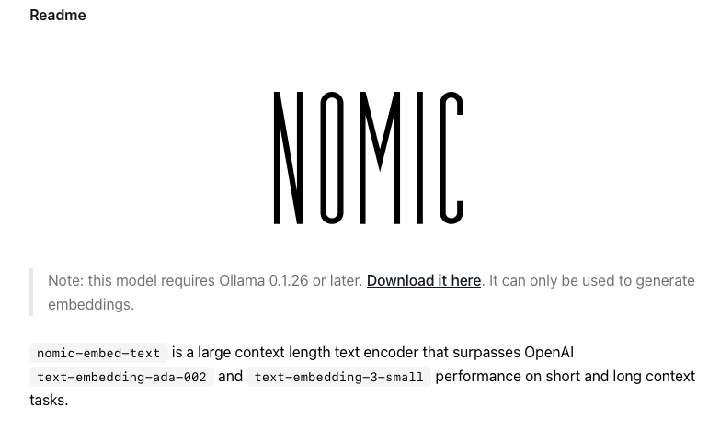
Embedding Model

Slide 15
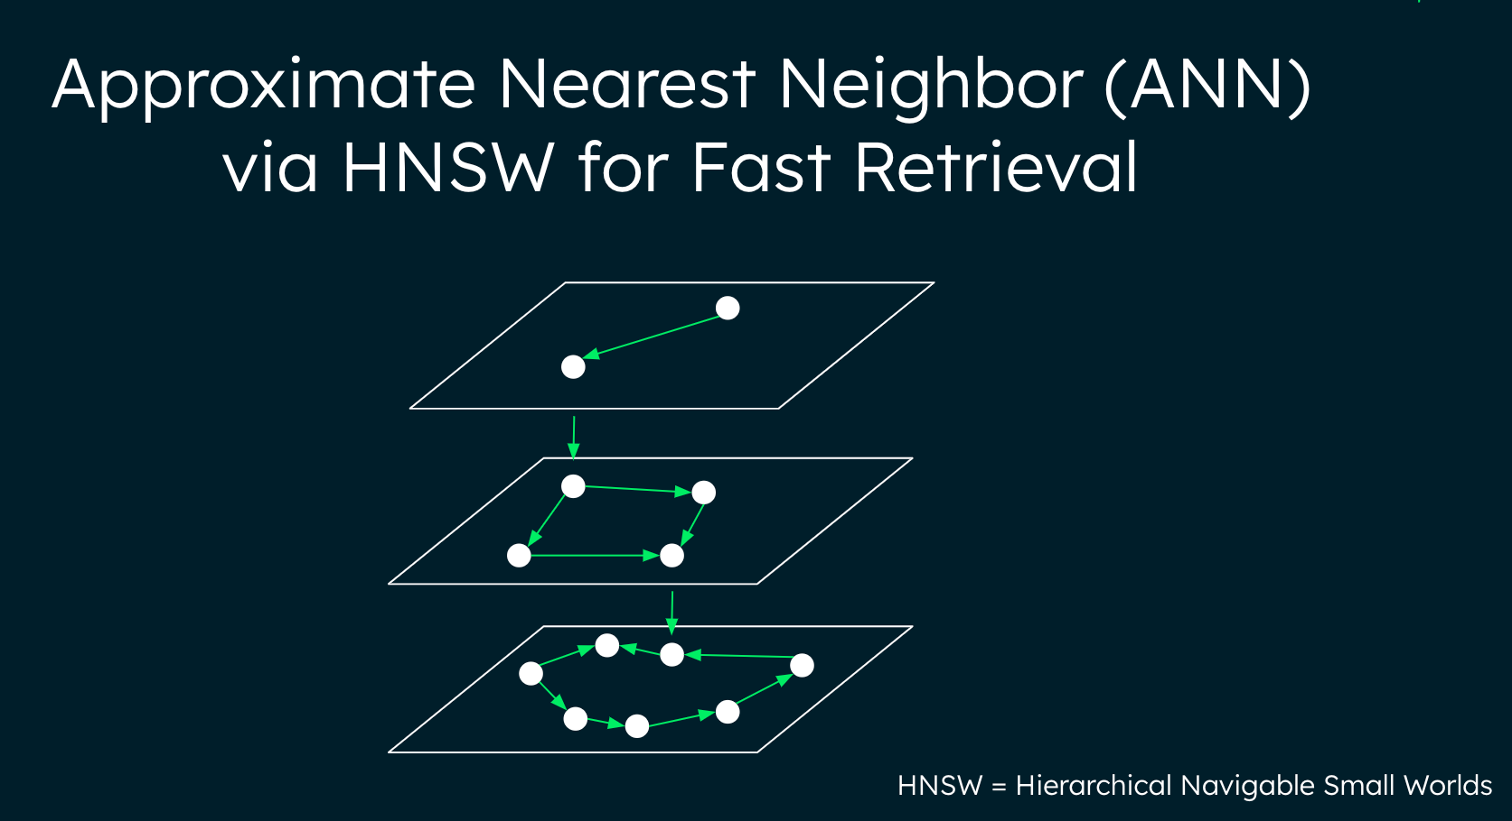
Hierarchical Navigable Small Worlds (HNSW) Algorithm
ANN stands for "Approximate Nearest Neighbors" and it is an approach to finding similar vectors that trades accuracy in favor of performance. This is one of the core algorithms used to power Atlas Vector Search.
The algorithm for Approximate Nearest Neighbor search uses the Hierarchical Navigable Small World (HNSW) graph for efficient indexing and querying of millions of vectors.
Notes:
Key Features of MongoDB’s Vector Search:
1. Hierarchical Navigable Small Worlds (HNSW) Algorithm:
• MongoDB employs the HNSW algorithm for efficient Approximate Nearest Neighbor (ANN) searches. This graph-based approach facilitates rapid retrieval of similar vectors without exhaustive dataset scans.
2. Cosine Similarity:
• MongoDB supports cosine similarity as a metric to measure the angle between vectors, effectively capturing their directional alignment. This is particularly useful in applications like text similarity and recommendation systems.

Slide 16
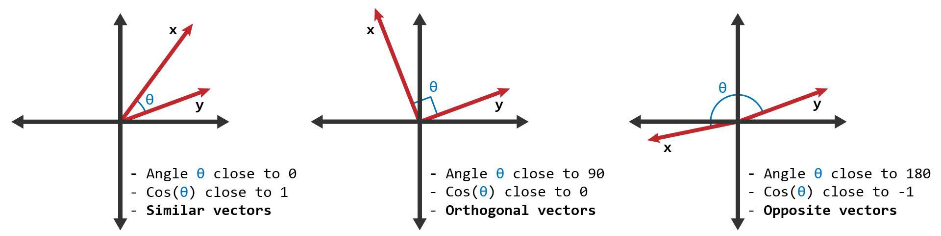
Cosine Similarity
• MongoDB supports cosine similarity as a metric to measure the angle between vectors, effectively capturing their directional alignment. This is particularly useful in applications like text similarity and recommendation systems.
Notes:
Key Features of MongoDB’s Vector Search:
1. Hierarchical Navigable Small Worlds (HNSW) Algorithm:
• MongoDB employs the HNSW algorithm for efficient Approximate Nearest Neighbor (ANN) searches. This graph-based approach facilitates rapid retrieval of similar vectors without exhaustive dataset scans.
2. Cosine Similarity:
• MongoDB supports cosine similarity as a metric to measure the angle between vectors, effectively capturing their directional alignment. This is particularly useful in applications like text similarity and recommendation systems.

Slide 17

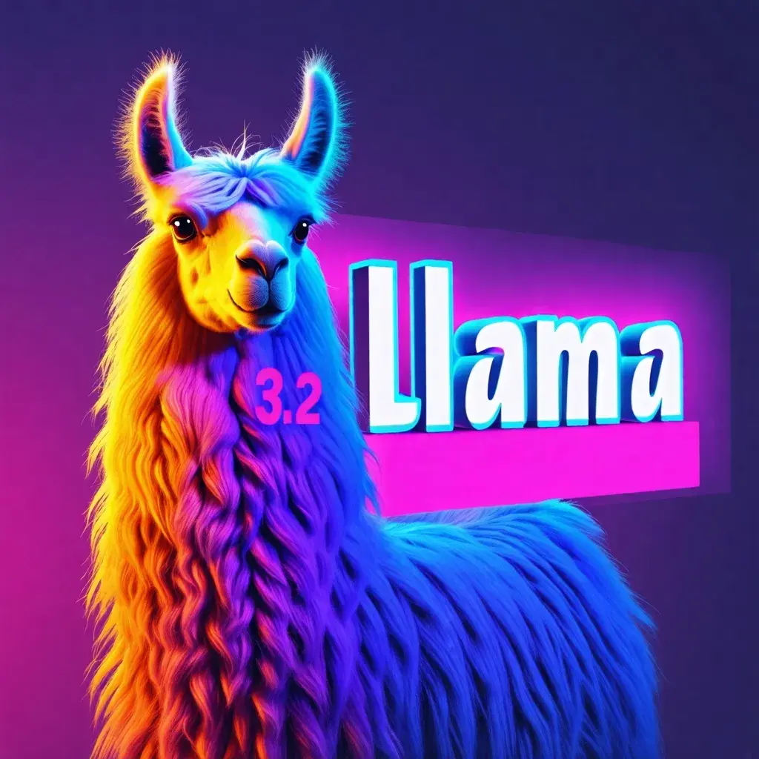
Generate smooth description
Notes:
“When recommending movies, presenting raw, structured data such as titles, genres, and plots can feel robotic and unengaging. Users appreciate a more natural, story-like recommendation format that flows like a real conversation.”
“The challenge is converting structured data into smooth, engaging descriptions without manual effort.”
“This is where LLaMA comes into play. LLaMA is a state-of-the-art language model capable of understanding context and generating human-like text.”
“By feeding structured data into LLaMA, we can generate natural-sounding recommendations tailored to user preferences.”

Slide 18
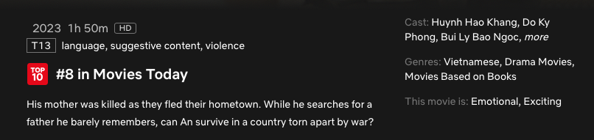
Generate smooth description
In this emotional Vietnamese drama, young An embarks on a perilous journey to find his estranged father in a war-torn country after losing his mother. Featuring Huynh Hao Khang and Do Ky Phong, this gripping film is a heartfelt tale of survival, resilience, and hope. Currently ranked #8 in today’s top movies!
Notes:
“When recommending movies, presenting raw, structured data such as titles, genres, and plots can feel robotic and unengaging. Users appreciate a more natural, story-like recommendation format that flows like a real conversation.”
“The challenge is converting structured data into smooth, engaging descriptions without manual effort.”
“This is where LLaMA comes into play. LLaMA is a state-of-the-art language model capable of understanding context and generating human-like text.”
“By feeding structured data into LLaMA, we can generate natural-sounding recommendations tailored to user preferences.”

Slide 19
04
Demonstration

Slide 20
Reference resources
MongoDB. (n.d.). Create an Atlas Search Index. [Website]. Retrieved from https://www.mongodb.com/docs/atlas/atlas-search/create-index/
Streamlit Docs. (n.d.). Retrieved from https://docs.streamlit.io/
ProtonX. (2024, May 23). Chi tiết về RAG - Retrieval Augmented Generation. [Video]. YouTube. https://www.youtube.com/watch?v=6523788337e7f90012890145
llama3.2. (n.d.). Retrieved from https://ollama.com/library/llama3.2
(N.d.). Retrieved from https://huggingface.co/datasets/MongoDB/embedded_movies
nomic-embed-text. (n.d.). Retrieved from https://ollama.com/library/nomic embed-text

Slide 21

Thank you!
Please keep this slide for attribution

